Slide 1
Fourier Transform Infrared Spectroscopy of CO₂ and Air
Esther Lin
ENPH 352
Introduction
Methodology
Conclusions
To understand and familiarize yourself with infrared spectroscopy as a measurement tool.
To measure and understand the absorption spectra of several gases
State objectives, intro to problem
Add and FTIR diagram
Add timing diagram for the laser the HeNe
Add your information, graphs and images to this section.
Background
Sample spectra, how to read spectra, normal modes, lineshapes
Results
References
Add interferogram, single beam spectra, and absorbance/transmission of Co2 and Air
Add your information, graphs and images to this section.

Slide 2
Fourier Transform Infrared Spectroscopy of CO2 and Air
Esther Lin | ENPH 352 | 11726156

Slide 3
Objectives
To understand and familiarize yourself with infrared spectroscopy as a measurement tool.
To measure and understand the absorption spectra of several gases

Slide 4
Theory
In the mid-infrared (MIR) region of the electromagnetic spectrum, molecules absorb (or emit) light through the interaction between the photons and the vibrating electric dipoles of the molecule.
In FTIR, a beam carrying many frequencies is shone on a sample. We measure how much of that beam is absorbed and transmitted by the sample.
With the transmission and absorbance spectra, we can identify the molecules in the sample.
http://brussels-scientific.com/?p=5975

Slide 5
General Setup
The FTIR is based on the Michelson interferometer. A laser with a range of wavelengths is shown on a beamsplitter, which splits the light into two branches. The first branch hits mirror M2, and get transmitted directly to the detector through the gas cell. The second beam travels to a translatable mirror M1. By shifting M1, different wavelengths are selected to pass through the gas cell. At the detector, it records the interaction of the beams with the molecules (interferogram) in the gas cell and sends the information to a computer for analysis with the Fourier Transform.

Slide 6
Method: Data Collection
Collect interferogram of system with no gas cell present to calibrate the FTIR translatable mirror to zero path length difference and maximum signal to noise. Sample interferogram below.
Purge the FTIR and gas cell sufficiently with N_{2.} Collect interferogram. This will be the normalization spectra.
Purge the gas cell with CO2. Collect interferogram.
Purge the gas cell with air, pumped from the air in the lab. Collect interferogram.

Slide 7
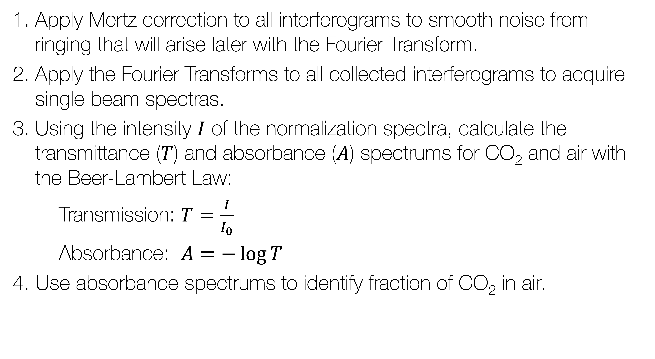
Method: Data Analysis
Apply Mertz correction to all interferograms to smooth noise from ringing that will arise later with the Fourier Transform.
Apply the Fourier Transforms to all collected interferograms to acquire single beam spectras.
Using the intensity $I$ of the normalization spectra, calculate the transmittance ($T$) and absorbance ($A$) spectrums for CO₂ and air with the Beer-Lambert Law:
Transmission: $T=\frac{I}{I_{0}}$
Absorbance: $A=−\log{T}$
4. Use absorbance spectrums to identify fraction of CO₂ in air.

Slide 8
Results: Mertz Correction
Comparison of spectra with and without Mertz correction. The Mertz correction method modulates the spectra with a triangular signal, to smooth out ringing with taking the Fourier transform of the interferogram. The spectrum with the Mertz correction is smoother and less noisy.

Slide 9
Results: Spectrums of CO₂

Slide 10
Results: Spectrums of Air

Slide 11
Results: Summary
Bond | Measured Wavenumber [cm-1]
CH
OH
smth
smth
Measured Fraction of CO2 in Air: Some value

Slide 12
Conclusions

Slide 13
References

